Slide 1
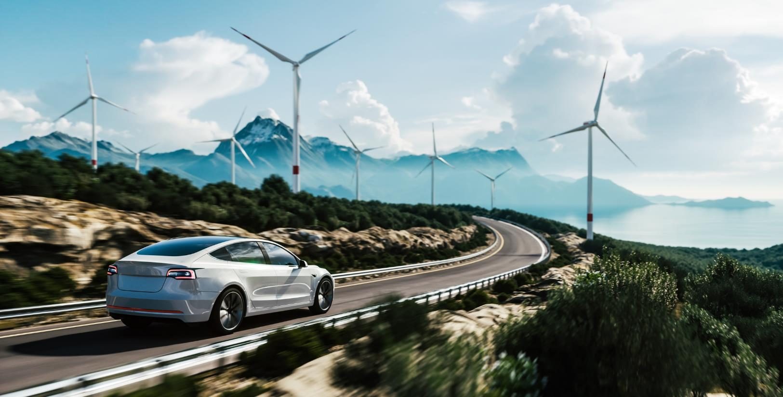
Battery metals, Western Australia
Developing a new nickel plant utilising the latest processing technology to unlock stranded ore

Slide 2
Disclaimer
This Presentation is provided by New Generation Minerals Limited (the “Company”) to a limited number of recipients, in connection with a possible investment in the Company (Investment).
The purpose of this presentation is to assist the recipient in deciding whether it wishes to proceed with a further investigation of the Company, and in determining the level of any indicative offer it may wish to make in connection with the Investment. This presentation does not constitute an offer or invitation in respect of the Investment, or of any other sale or purchase of securities, or of any of the businesses or assets described in the presentation.
The information in this presentation, which does not purport to be comprehensive, has been provided by the Company and has not been independently verified. While the presentation has been prepared in good faith, no representation, warranty, assurance or undertaking (express or implied) is or will be made, and no responsibility or liability is or will be accepted by the Company, or any of the Company's subsidiaries or by any of their respective officers, prospective officers, employees or agents in relation to the adequacy, accuracy, completeness or reasonableness of this presentation, or of any other information (whether written or oral), notice or document supplied or otherwise made available to any interested party or its advisers in connection with the Investment. All and any such responsibility and liability is expressly disclaimed. In particular, but without prejudice to the generality of the foregoing, no representation, warranty, assurance or undertaking is given as to the achievement or reasonableness of any future projections, management estimates, prospects or returns contained in this presentation, or in such other information, notice or document. The recipient acknowledges and agrees that no person has, nor is held out as having, any authority to give any statement, warranty, representation, assurance or undertaking on behalf of the Company in connection with the Investment.
To the maximum extent permitted by applicable laws, none of the Company or its related entities or their employees, officers or advisers makes any representation and none of them gives any assurance, guarantee or warranty, express or implied, as to, and none of them takes any responsibility or assumes liability (including in negligence) for the authenticity, validity, accuracy, suitability or completeness of, or any errors in or omissions from, any information, statement or opinion contained in this presentation.
This presentation contains certain forward-looking statements which have not been based solely on historical facts but, rather, on the Company’s current expectations about future events and on a number of assumptions which are subject to significant uncertainties and contingencies, many of which are outside the control of the Company and its directors, officers and advisors. Many factors could cause actual results, performance or achievements of the Company to be materially different from these forward-looking statements including, amongst other things, changes in general economic and business conditions, regulatory environment, exchange rates, results of advertising and sales activities, competition, and the availability of resources and materials. The Company undertakes no obligation to update these forward-looking statements for events or circumstances that occur subsequent to such statements or to keep current any of the information provided. Any estimates or projections as to events that may occur in the future (including projections of revenue, expense, net income and performance) are based upon the best judgement of the Company and there is no guarantee that any of these estimates or projections will be achieved. Actual results will vary from the projections and such variations may be material. The Company has no obligation to tell recipients if it becomes aware of any inaccuracy in or omission from the information in this presentation.
This presentation should not be considered as the giving of investment advice by the Company or any of its shareholders, directors, officers, agents, employees, or advisers. Each party to whom this document is made available must make its own independent assessment of the Company after making such investigations and taking such advice as may be deemed necessary. If you are in any doubt in relation to these matters, you should consult your stockbroker, bank manager, solicitor, accountant, taxation adviser or other independent financial adviser
By accepting this presentation, you acknowledge and agree to be bound by each of the foregoing statements
Notes:
New disclaimer

Slide 3
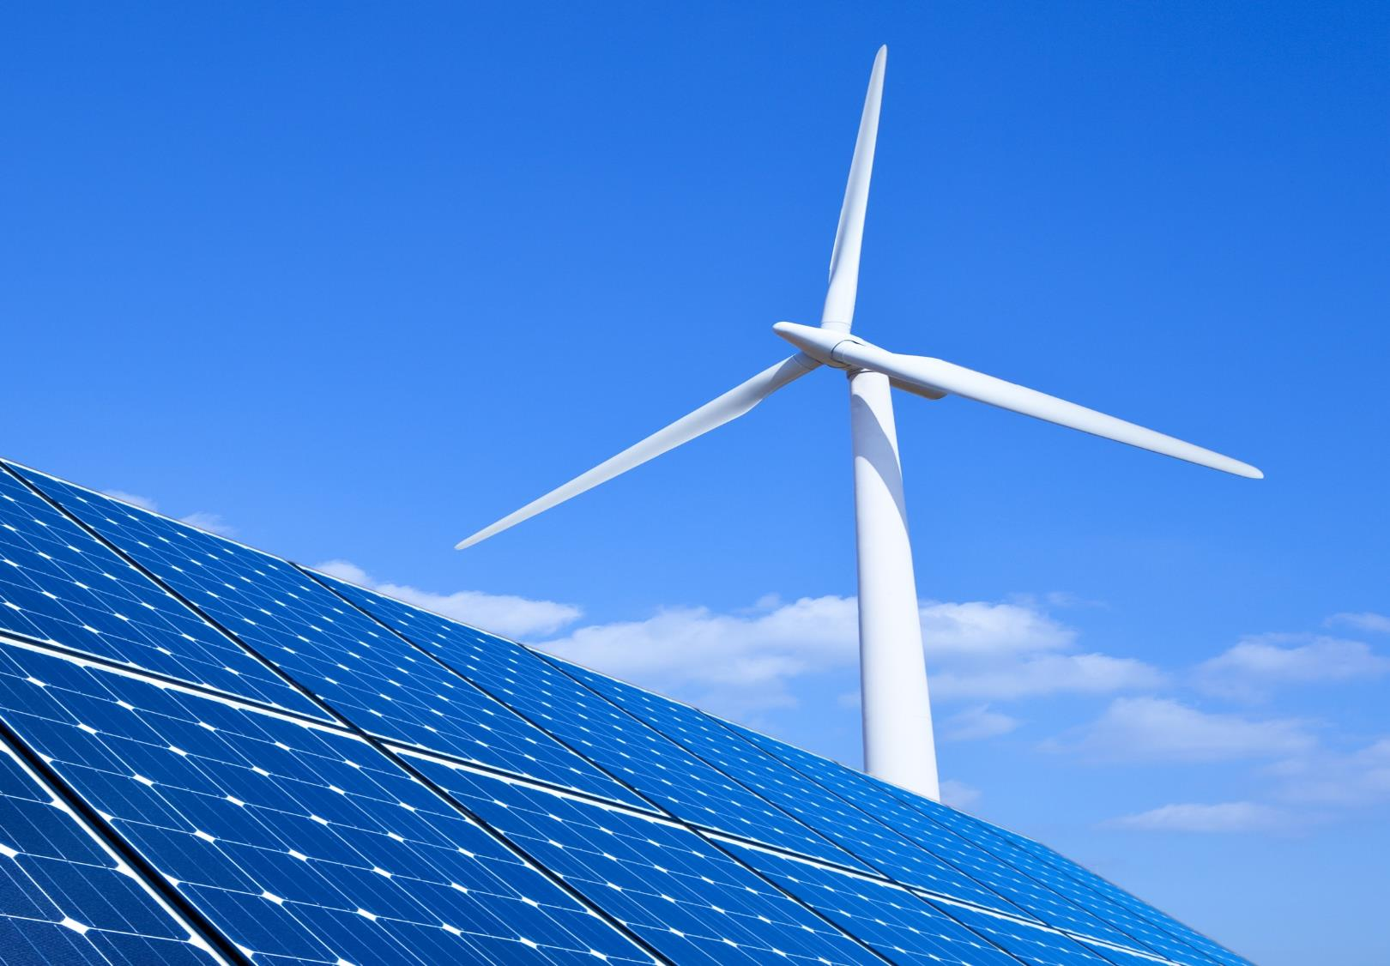

Snapshot
UK company planning nickel-cobalt plant in WA
Best practice ESG standards
Providing ethically sourced metals to EV markets
Additional projects including gold and lithium exploration at Kathleen Valley in partnerships with listed companies
Latest technology
Direct nickel: plant will use latest green processing technology DNi ProcessTM
Best location
2028
Western Australia: best ESG nickel mining location in the world
Production of battery grade nickel-sulphate
ASX IPO
PFS
Q1 2024; raising A$2m leading to IPO raise A$8m
IPO funds to complete Preliminary Feasibility Study

Slide 4


Portfolio overview
Four projects in WA including:
  Nickel-cobalt (primary project being driven by NGM)
    Intention to build new plant (2028) in the heart of the WA nickel region producing:
      16,000 tpa contained nickel in sulphate
      1,625 tpa contained cobalt in sulphate
    Ore supply from NGM’s deposit near Kalgoorlie plus MoU with Riversgold (ASX: RGL) to acquire additional nickel tenements
    Seeking strategic offtake partner
  Gold
    Advanced exploration at Kathleen Valley tenement with Mila Resources (LSE: MILA) (25% owned by NGM)
  Lithium
    Agreement for Liontown Resources (ASX:LTR) to explore lithium potential at NGM’s Kathleen Valley tenement
  Other projects
  Early-stage tenements with gold and battery metal potential

Slide 5
Why invest in Australian nickel
Australia has the joint largest reserves in the world, but produces only 10% of that of Indonesia
(see appendix slide 17)
Nickel demand to increase 65% by 2023 according to the IEA
Ethical sourcing – reduce reliance on Indonesia
Australia in great position to expand production capacity to meet global demand
v

Slide 6
Better processing technology
DNi ProcessTM compares well against traditional High Pressure Acid Leach (HPAL) plants
Advantages
More tolerant of ore range
Lower pressure
Lower temperature
Less acid
Less waste
Studies indicate that the operating costs will be much lower (see appendix)
 | DNi ProcessTM | HPAL
Ore | Tolerant of full range | Preference for selective ore
Pressure | Lower pressure 1 atmosphere | High pressure 40 atmosphere
Temperature | Lower temperature 110°C | High temperature 250°C
Acid consumption | Less acid 30-80 kg / tonne ore | More acid 250-500 kg / tonne ore
Waste materials | Landfill / return to mine | Generates 4x quantity and requires cleaning
Critical advantages of DNi ProcessTM vs HPAL:
DNi ProcessTM generates inert residue with traces of nitrates which act as a fertiliser and make it ideal for blending with topsoil for mine rehabilitation
Creates about only 20% of the waste generated by HPAL and this presents savings in transport and the risks of tailings dams
It processes the whole of the laterite profile, allows almost immediate mine rehabilitation
See appendix slides 12-13

Slide 7

Why invest in this project
Right location, right technology, right growth metals
Nickel processing capacity in WA is grossly insufficient; there are millions of tonnes of stranded ore lacking processing options
The plant will:
    be close to infrastructure and skilled workforce
    utilise patented DNi ProcessTM to process low-grade ore in an environmentally friendly way
De-risked technology:
  ASX:QPM building a A$2Bn plant in Queensland based on DNi ProcessTM technology with pre-tax IRR 18.5% and NPV o$2.7Bn
Rapid timeline: mining operations and processing within 5 years
Multiple revenue streams of saleable products
Off-take and debt funding, government grants and R&D tax credits
Green focus
Clean energy is a priority – solar power and solar desalination
Low pressure and temperature processing
Seek carbon credits
Zero waste, return residue directly to pits and rehabilitation
Seek socio economic benefits by working local community for mutual returns on green-power and permanent local jobs
Key enablers for success
2nd plant built with new technology
Solar solution for power and water
Community and government support

Slide 8
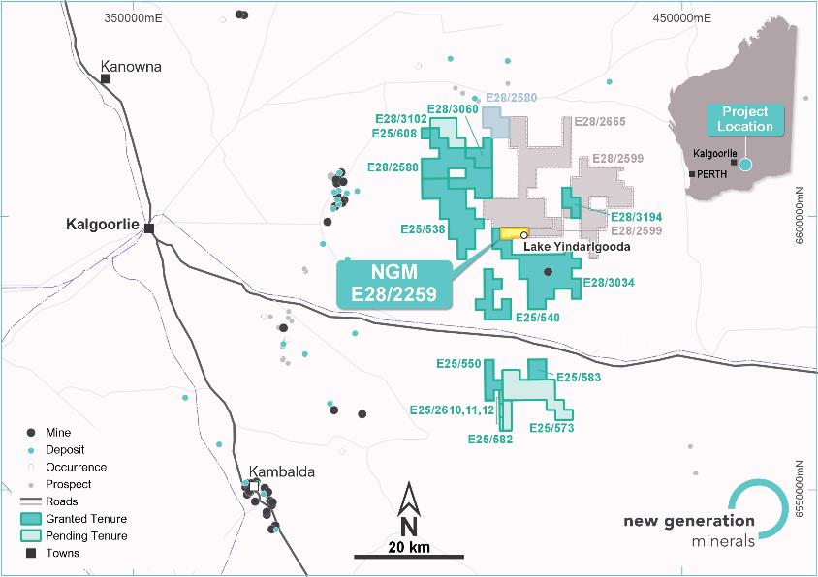
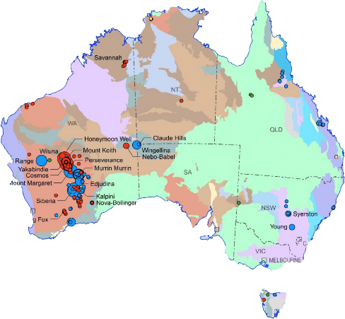
Excellent mineral footprint – heart of Australian nickel
NGM has access to a large mineral footprint close to Kalgoorlie in heart of WA’s nickel region - numerous nickel laterite deposits without clear route to processing
  NGM owns Lake Yindarlgooda nickel-cobalt deposit ~60km east of Kalgoorlie
  NGM also has a commercial arrangement with Riversgold (ASX: RGL) for nearby Kurnalpi tenements
  Discussions are ongoing for several additional resources
Australian nickel deposits
>95% of nickel in Western Australia
Nickel laterite deposits are surface-lying oxides, 10-50m thick, generally 0.8-1.2% nickel and beneficiation can create a 1.5% ore feed
7

Slide 9
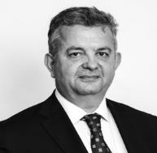
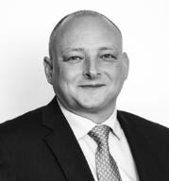




Experienced team
Arthur Darivas CEO | Dr Patrick Kennedy Director | Neil Hutchison Director | Craig Roelofsz Director | Robert Boston Advisor
CEO of TPE Group (NGM subsidiary) and NGM for past five years. Corporate finance background, former Orica Mining Services (OMS), GM Global Finance Manufacturing & Supply Chain, former CFO of OMS, Australia and Asia and former CFO of OMS, Latin America | Chartered Mining Engineer with copper-gold production with Rio Tinto. Former Hanwha Mining services COO – Australia, Chile, Indonesia. Former head of Orica Mining Services, Western Australian Goldfields. Extensive mining project and contracting experience. Currently UK Government Dept Trade and Industry mining specialist advisor | Professional Geologist with extensive corporate and field experience as an exploration geologist. 10+ discoveries and resource definitions including Bulchina Gold Mine, Minotaur Gold Mine, Cerberus nickel deposit, Andover nickel deposit, and NGM’s Kathleen Valley | Lawyer with extensive corporate and commercial law experience, focused on capital raisings, M&A, joint ventures, intellectual property and corporate governance. Prior to establishing boutique corporate and commercial law firm in 2013, Craig worked in leading South African and Australian law firms | Resources executive, having held roles within BHP Billiton Limited (Nickel West), Rio Tinto, Poseidon Nickel and Austal and continues to advise and be a non-executive director for a number of junior resources companies. Prior to this he worked for Freehills and Mallesons Stephen Jaques. Operationally Robert has participated in completion of numerous scoping, feasibility and pre-feasibility studies along with fund raisings and project financing for project development and mine restarts
Altilium has a highly experienced team located in key mining locations and is backed by supportive partners

Slide 10
Use of funds
The main deliverable from the IPO will the Preliminary Feasibility Study (PFS)
Workstreams
Engineering – optimise flowsheet and equipment selection
Resource – increase mineral resource to 20 years of ore supply
Power and water – green solutions to meet the plant’s needs
Mining and transport – methodology and cost assumptions
Target site identified – land requirements clearly defined
Community and government engagement
Off-take strategy vs funding models
Principles
Move swiftly
Learn from the plant being built by Queensland Pacific Metals (ASX: QPM)
Utilise project resources rather than build a prematurely large organisation
 | A$m
Project management, community and government | 1.0
Engineering | 4.0
Exploration | 2.0
Governance, administration and regulator | 1.0
Total | 8.0

Slide 11

Contacts
New Generation Minerals Arthur Darivas Chief Executive Officer
arthur.darivas@newgenerationminerals.com
Investor Relations Vigo Consulting
newgenerationminerals@vigoconsulting.com

Slide 12
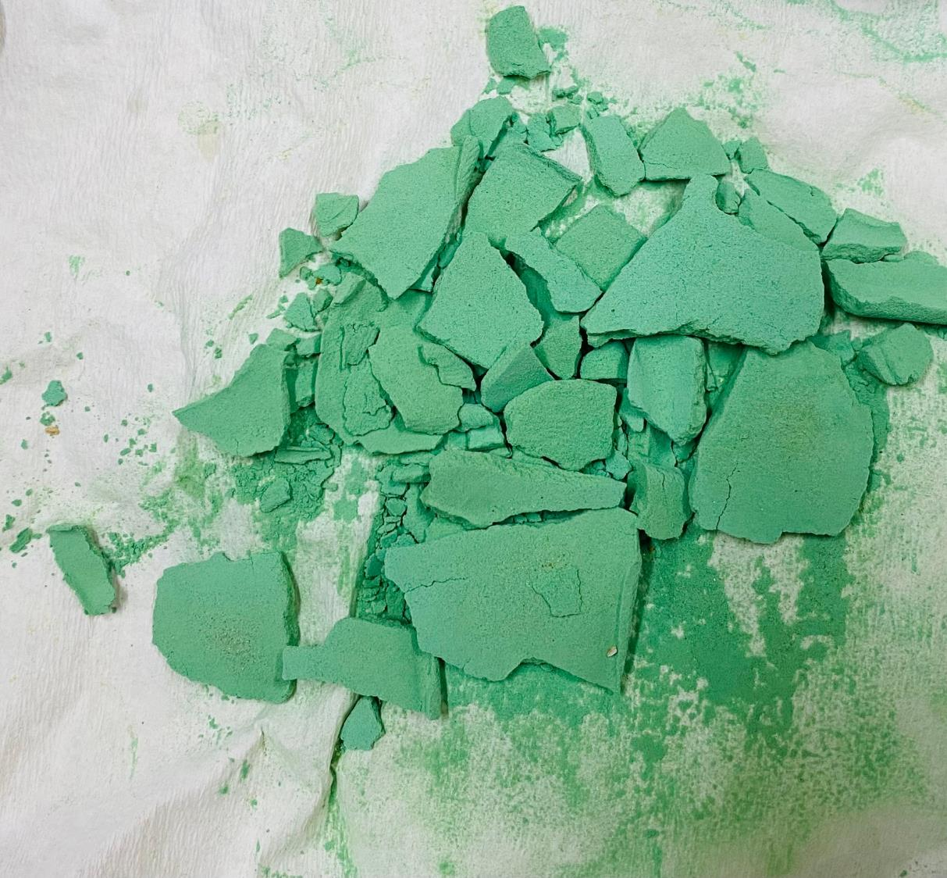
Appendix
Image of mixed hydroxide product (MHP) - the preferred feed material for refineries that supply EV battery manufacturers

Slide 13
DNi ProcessTM
How is the DNi ProcessTM a safer, greener and more profitable alternative?
The DNi ProcessTM delivers nickel and cobalt in the form of a mixed hydroxide product (MHP) which is the preferred feed material for refineries that supply EV battery manufacturers. Currently, the dominant source of MHP is the high-pressure acid leach (HPAL) technology. Here’s how it stacks up against the DNi ProcessTM
The DNi Process™ | HPAL
MAIN PRODUCT: Mixed (Ni-Co) Hydroxide Product | MAIN PRODUCT: Mixed (Ni-Co) Hydroxide Product
CO-PRODUCTS: Hermatite, Magenisa, Aluminium Hydroxide, Manganese, Scandium | CO-PRODUCTS: Ammonium Sulfate, Scandium
ORE FEED: Processes full lateritic ore profile (ilmenite, saprolite and transition zone) | ORE FEED: Primarily processes the limonite ore because Mg in the saprolite increases acid consumption materially
PRESSURE: Operates at 1 atmosphere | PRESSURE: Requires at least 40 atmospheres
TEMPERATURE: Extracts metals at 110°C | TEMPERATURE: Extracts metals at 250°C
PLANT MATERIALS: Simpler materials of construction | PLANT MATERIALS: Requires one or more submarine-sized titanium autoclaves which are then lined with exotic ceramic bricks to prevent the H2S04 from damaging the autoclave
TECHNOLOGY: Easily scalable (stirred tanks, not complex pressure vessels) | TECHNOLOGY: Challenging technology with historical projects generating poor returns – there are currently no plants smaller than 30,000t per annum of Ni
ACID CONSUMPTION: 30-80kg of nitric acid per tonne of processed ore is consumed, while over 99% of the acid is reused | ACID CONSUMPTION: 250-500kg of sulphuric acid per tonne of processed ore is consumed, most of which needs to be neutralised before being disposed in a tailings dam or the sea
WASTE MATERIAL: Generates around 200kg of residue from every 1,000kg of ore processed* - the residue is inert and mainly consists of silicates and can be dry-stacked and returned to the mine | WASTE MATERIAL: After neutralising with the addition of limestone, the tailings equal around 1.5 times the weight of the ore feed. These are then deposited into a tailings dam or the sea
*Actual volume is largely determined by the iron content of the ore
Source: https://www.altiliumgroup.com/the-dni-process/

Slide 14
DNi ProcessTM vs HPAL
DNi ProcessTM produces 20% of the waste of HPAL
and is soil friendly

Slide 15
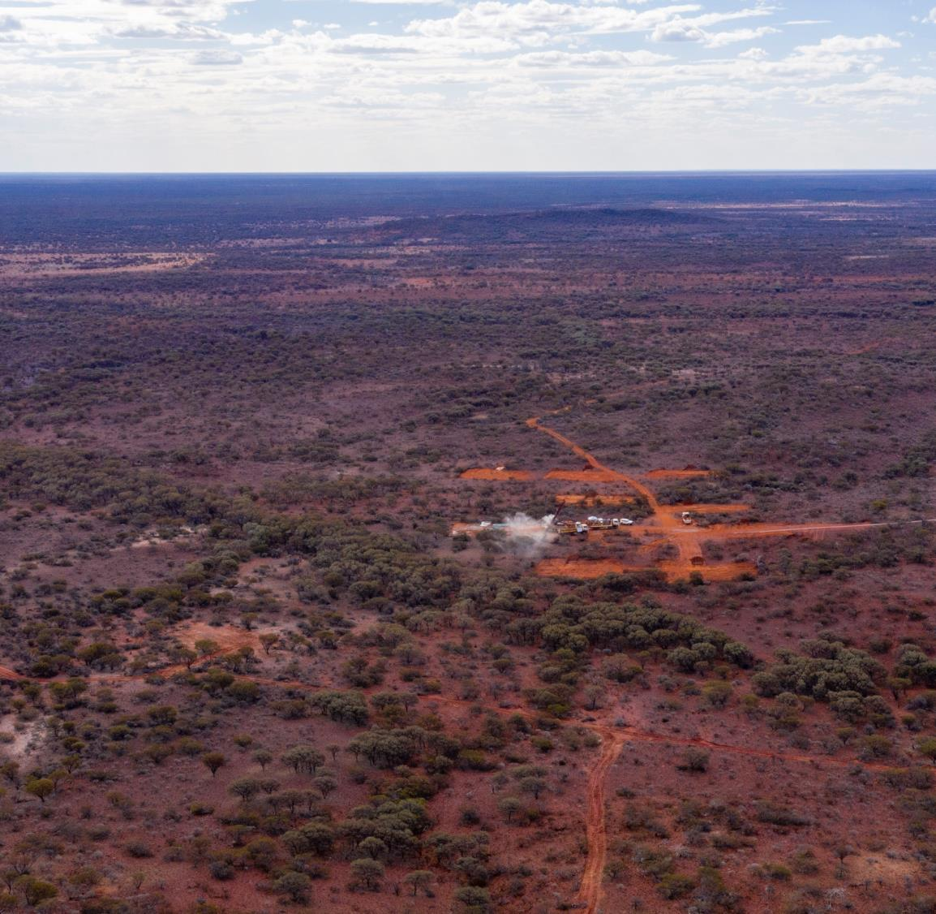


NGM project portfolio
Lake Yindarlgooda: JORC Inferred nickel-cobalt resource plus two gold areas of interest
Kurnalpi: MoU with ASX-listed Riversgold to take over nickel rights upon listing (area surrounding Lake Yindarlgooda)
Kathleen Valley: Most advanced project with three gold targets being explored in partnership with LSE-listed Mila and lithium potential exploration in partnership with ASX-listed Liontown
Highway: Nickel, copper, cobalt, and gold potential
Volcano Bay: Nickel, copper, cobalt, gold, and Pt-Pd potential
Kathleen Valley
Kurnalpi
Lake Yindarlgooda
Highway
Volcano Bay
Resources
 | Kathleen Valley | Kathleen Valley | Lake Yindarlgooda
Mineral | Gold | Gold | Ni-Co
JORC Code | Inferred | Exploration Target | Inferred
Values | 21,000 oz gold | 145,000-280,000 oz gold | 28,400 t contained nickel

Slide 16
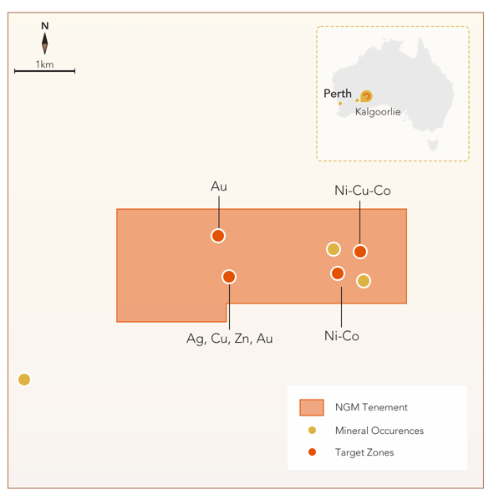
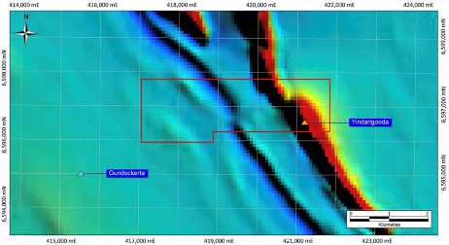
Lake Yindarlgooda nickel-cobalt
Next steps are an exploration programme targeting expansion of the JORC resource
  8 sq km tenement
  80% NGM / 20% Modern Metals
  JORC Inferred resource of 3.8 Mt nickel at 0.75% (cut-off grade of 0.5% nickel) for 28,400 t contained nickel
  Gold targets not yet drilled (one gold and the other
  silver/copper/zinc/gold)
  Conduct a mining and processing review of options
  Plan to drill 33 holes, totalling 3,100m, in next campaign:
  Expand JORC Inferred nickel-cobalt resource with
  25 new holes totalling 1,500m
  Explore two gold targets with 8 new holes totalling
  1,600m

Slide 17
Australia needs multiple new nickel plants
There is enormous potential for expansion in Australian nickel production
Multiple processing plants and mines needed – more than 25 plants
Several projects in consideration, but still not enough to close the gap
  There are 3 nickel operations in Australia
  Multiple new projects and expansions are required
Australia ticks the ESG standards boxes that the first four global producers do not
There is pressure on Australia to upgrade minerals in-country
Annual nickel production (000t)
There are four new proposed projects, if all four are built, they will only fill this much gap
Source: NICKEL INVESTING, Top 9 Nickel-producing Countries (Updated 2023) Melissa Pistilli, May. 29, 2023

Slide 18

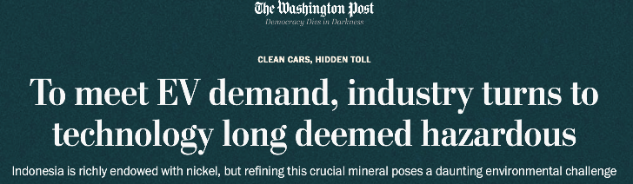
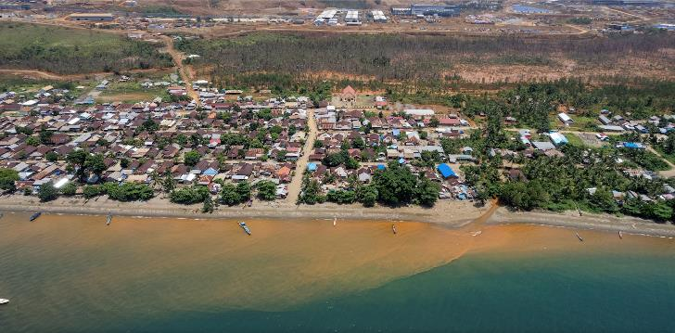
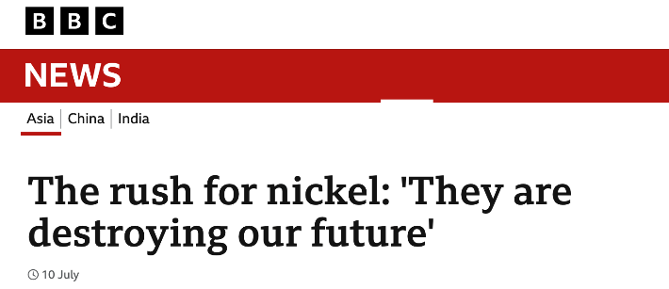
Key issues: Australian vs Indonesian nickel
Indonesia is destroying local communities and fisheries with polluted nickel mining waste from coastal mines
Driven by Chinese demand and investment, Indonesia is investing in HPAL (high pressure acid leaching technology), a technology many players walked away from 20 years ago
Australia nickel deposits not coastal
Australia already investing on DNI technology, (ASX: QPN) and better alternative to HPAL
Western Australia World No.1 for mining investment and ESG / ethical mining (Fraser Institute)
Indonesia (2023)
Indonesia (2023)
Washington Post, May 10th 2023
BBC, July 10th 2023

Slide 19
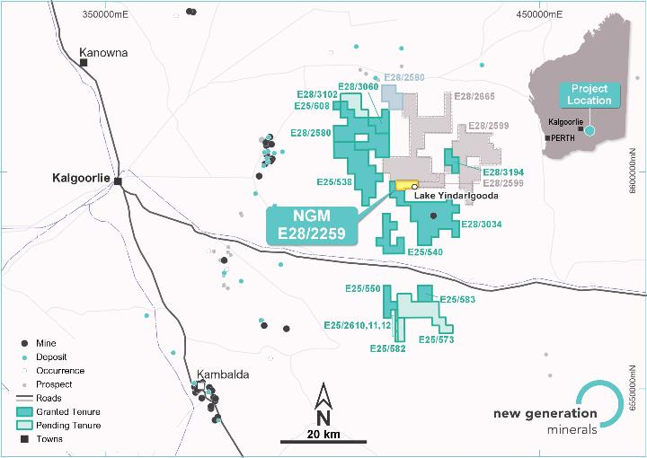
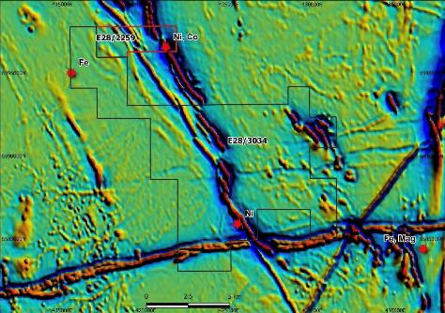
Kurnalpi nickel-cobalt
Significant land package around Lake Yindarlgooda
  (7 August 2023) NGM signed MoU with Riversgold (ASX: RGL) to acquire package of prospective nickel tenements proximal to NGM’s Lake Yindarlgooda project
  389 sq km of tenements
  Riversgold will be issued shares in NGM subsidiary listing on ASX
  NGM will gain access to potential significant nickel-cobalt mineralisation as well as the ability to expand existing Lake Yindarlgooda JORC resource
  (March 2023) Study was conducted by HGS Australia to demonstrate presence of nickel
  Next step is to design an exploration programme to seek a JORC resource estimate at tenement E28/3034 and identify Ni-Co deposits elsewhere in the package

Slide 20
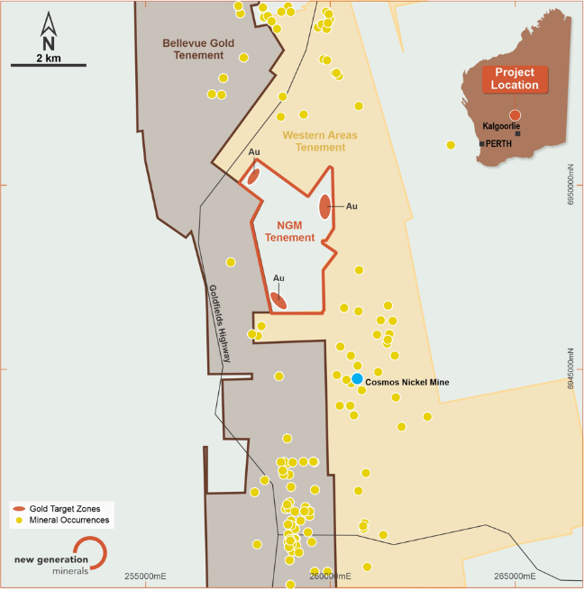
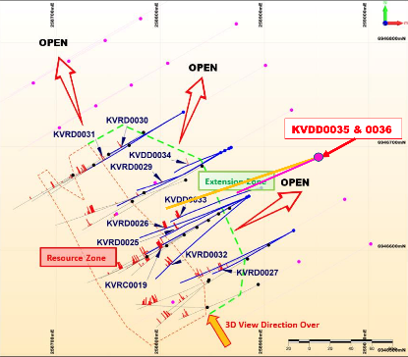

Kathleen Valley gold
Gold project close to Bellevue Gold, farm-in agreements with Mila Resources (LSE: MILA)
  7 sq km tenement
  50% NGM / 30% Mila / 20% Modern Metals
  8,132m drilled to date
  New high-grade 6.6m section of ~15g gold and 22g silver, new peak gold 27.6g (previous high 14g)
  Resource:
    Current JORC Inferred 22k oz
    Current JORC Target 145-280k oz
  (16 Nov 2020) Farm-in deal will see NGM’s remaining project share transferred to Mila in exchange for additional Mila shares, subject to exploration expenditure by Mila
Liontown
  NGM currently owns approximately 25% of Mila
Bellevue

Slide 21
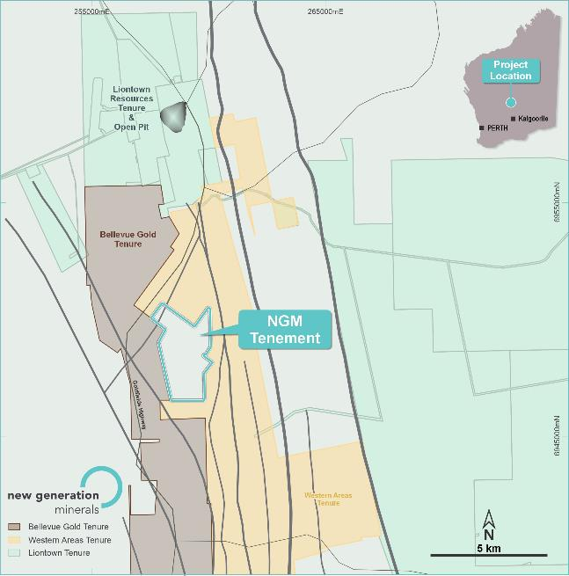
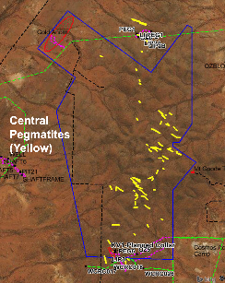
Kathleen Valley lithium
Agreement with Liontown (ASX: LTR) to explore for lithium on NGM tenement which is close to Liontown mine and mill in construction
  7 sq km tenement
  50% NGM / 30% Mila / 20% Modern Metals
  Mapping hard rock lithium bearing pegmatites at the project with surface values of up to 3.5% Li2O
  The pegmatites resemble those expected to be mined by Liontown just 7.5km to the north
  Independent Geological Consultants, CSA Global, share the opinion that the site has good potential for hosting lithium spodumene bearing pegmatites
Liontown
Bellevue

Slide 22
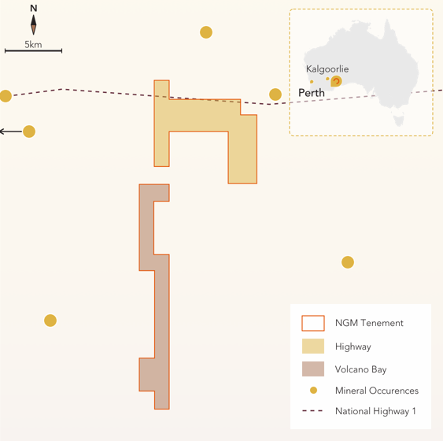
Highway and Volcano Bay
Two adjacent tenements with gold and battery metals potential
  Highway
  63.9 sq km tenement
  Early greenfield stage with exploration targets
  Tholeiite intrusive nickel-copper-cobalt, komatiite volcanic nickel-copper-cobalt, nickel-cobalt laterite, archaean orogenic gold and tropicana-style gold
Volcano Bay
49.3 sq km tenement
AngloGold Ashanti auger programme (2011) identified ultramafic intrusive - could hold nickel-copper sulphide
Prospective for copper-gold with early exploration returning auger values of 4 ppb gold
Auger soil geochemical survey returned three anomalous areas
  Two platinum-palladium
  One gold
  Both intimately associated with magnetic features beneath cover - never tested
  Both projects 70% NGM / 30% Modern Metals and others

Slide 23
Timetable to listing
ASX IPO Q1 2024
 | Q3 23 |  |  | Q4 23 |  |  | Q1 24
Preliminary Economic Assessment
Broker mandate signed
primary ore commercial deal
Secondary ore arrangements
Capital structure
Strategic off-taker MOU
Altilium Commercial Agreement
FEL planning / working capital model
Application in Principle (ASX)
Prospectus live
Listing on ASX
✓
Completed
✓
Completed
Completed
✓

